Slide 1
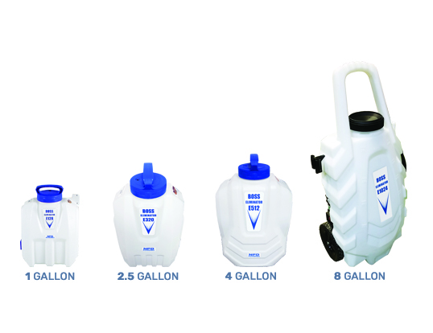
Boss Eliminator Series - Spray Applicators
2 Spray Applicators In One
Misting Applicator for: Mosquitoes, Disinfecting, Other Services
General Pest Control Applicator: Using Fan and Pin/Cone Spray Tips
18 Volt Rechargeable Battery

Slide 2
Boss Eliminator - Mosquito Misting Spray Applicator
18 Volt Rechargeable Battery, Backpack
Two speed settings covering Mosquito and General Pest Control applications.
Misting up to 20 ft from the ground to target mosquito harbourage zones.

Slide 3
E Series Applicator Features
Provide application equipment that provides consistent replication for chemical application volumes. Factors: Pump, Electronic Circuit Boards, Battery Reliability.
Provide the tools (Spray Tips) to meter out the chemical volumes as per label instructions. Factors: Misting, Fan, Pine, Cone. Brass, Stainless Steel, 11/16 standard industry threads.
Calibratable applicators, balance of training required is to demonstrate the speed of chemical application by the operating technician.
Provide the first 3rd party Misting Droplet Analysis Report directed for Mosquito applications, showing our custom designed misting applicators performance has valuable assets. The complete system (Eliminator) is required for these results.
Total backpack system Water loaded is 28.5 lbs. Based on 2.5 Gallon models. Meets Guideline for Maximum Handling Loads.

Slide 4
Backpack Applicator Features
Designed for exterior and interior application pressures and output rates. The E Series 1 Gallon model provides same features as the 2.5 but is designed for interior applicators because of its light weight and size.
Operating cost based on 3 years (720 working days) is less than $1.00 a day.
Demonstration and repair videos provided.
Video Training Studio (4 camera 1500 sq ft.)

Slide 5
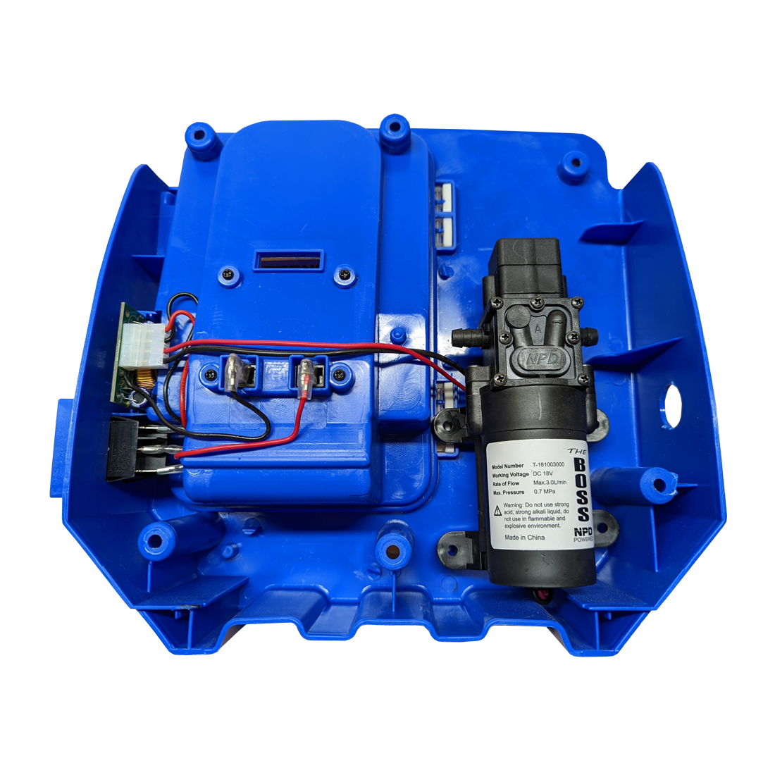
Backpack Applicator Features
Provide a cost-effective maintenance system that deals with equipment down time, freight costs, ease of installation at field level. Complete Operating System replacement, 20-minute installation, 100% up and running guarantee.
Operating System

Slide 6
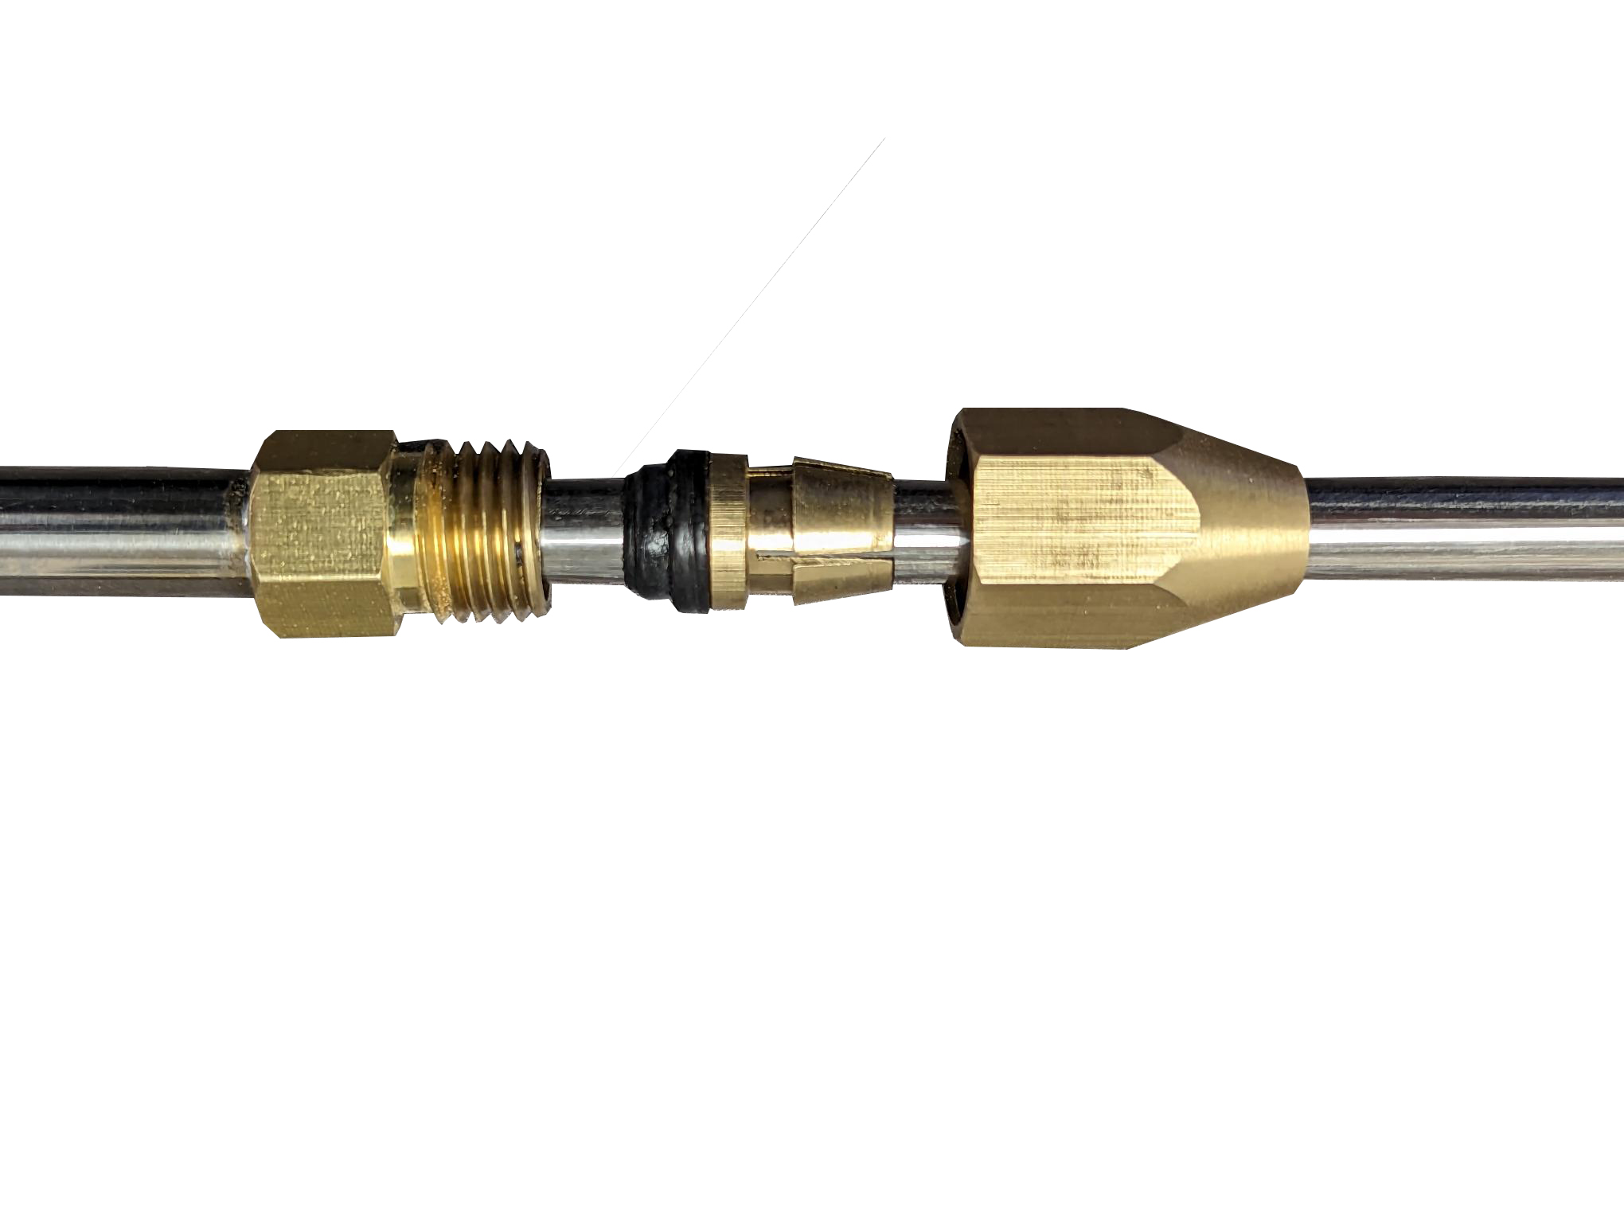
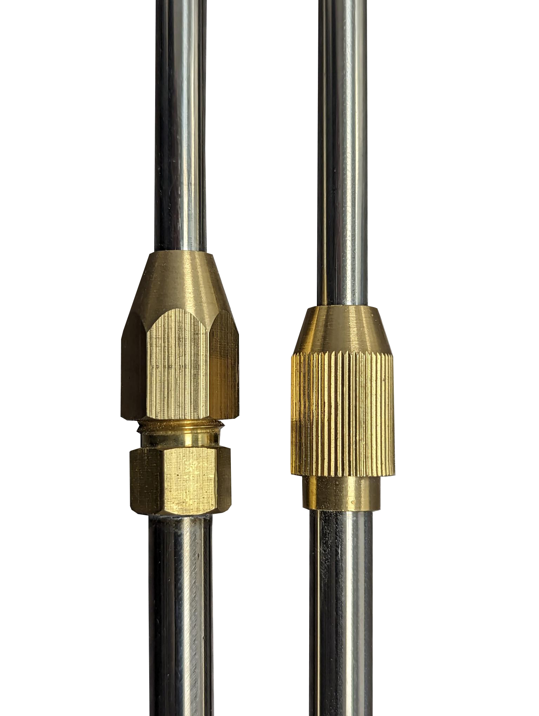
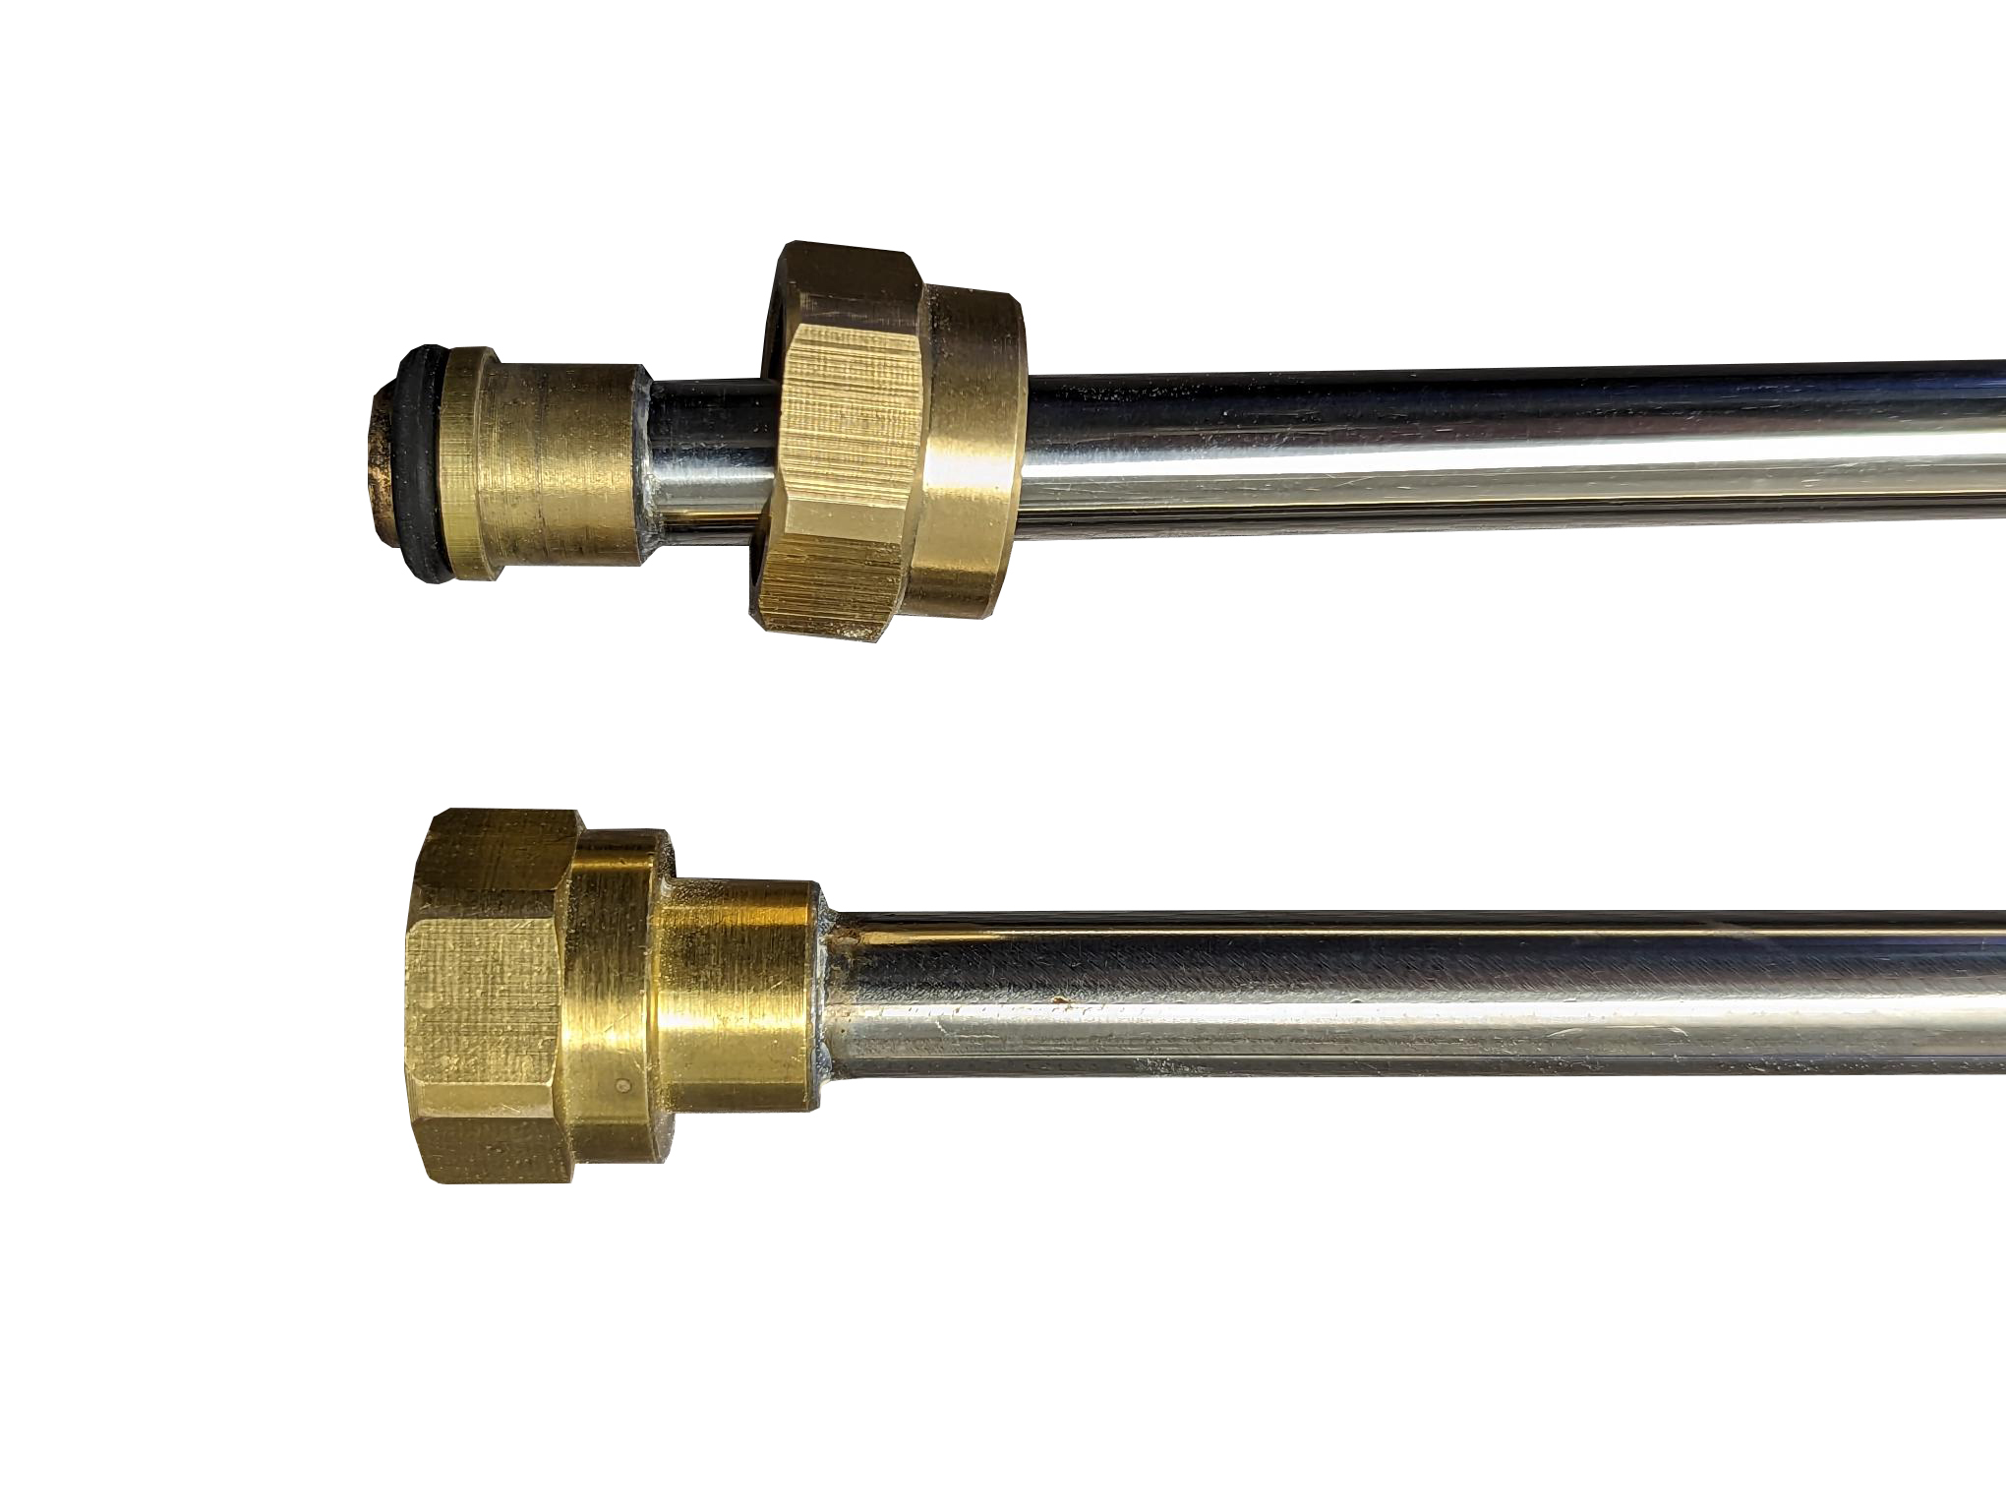
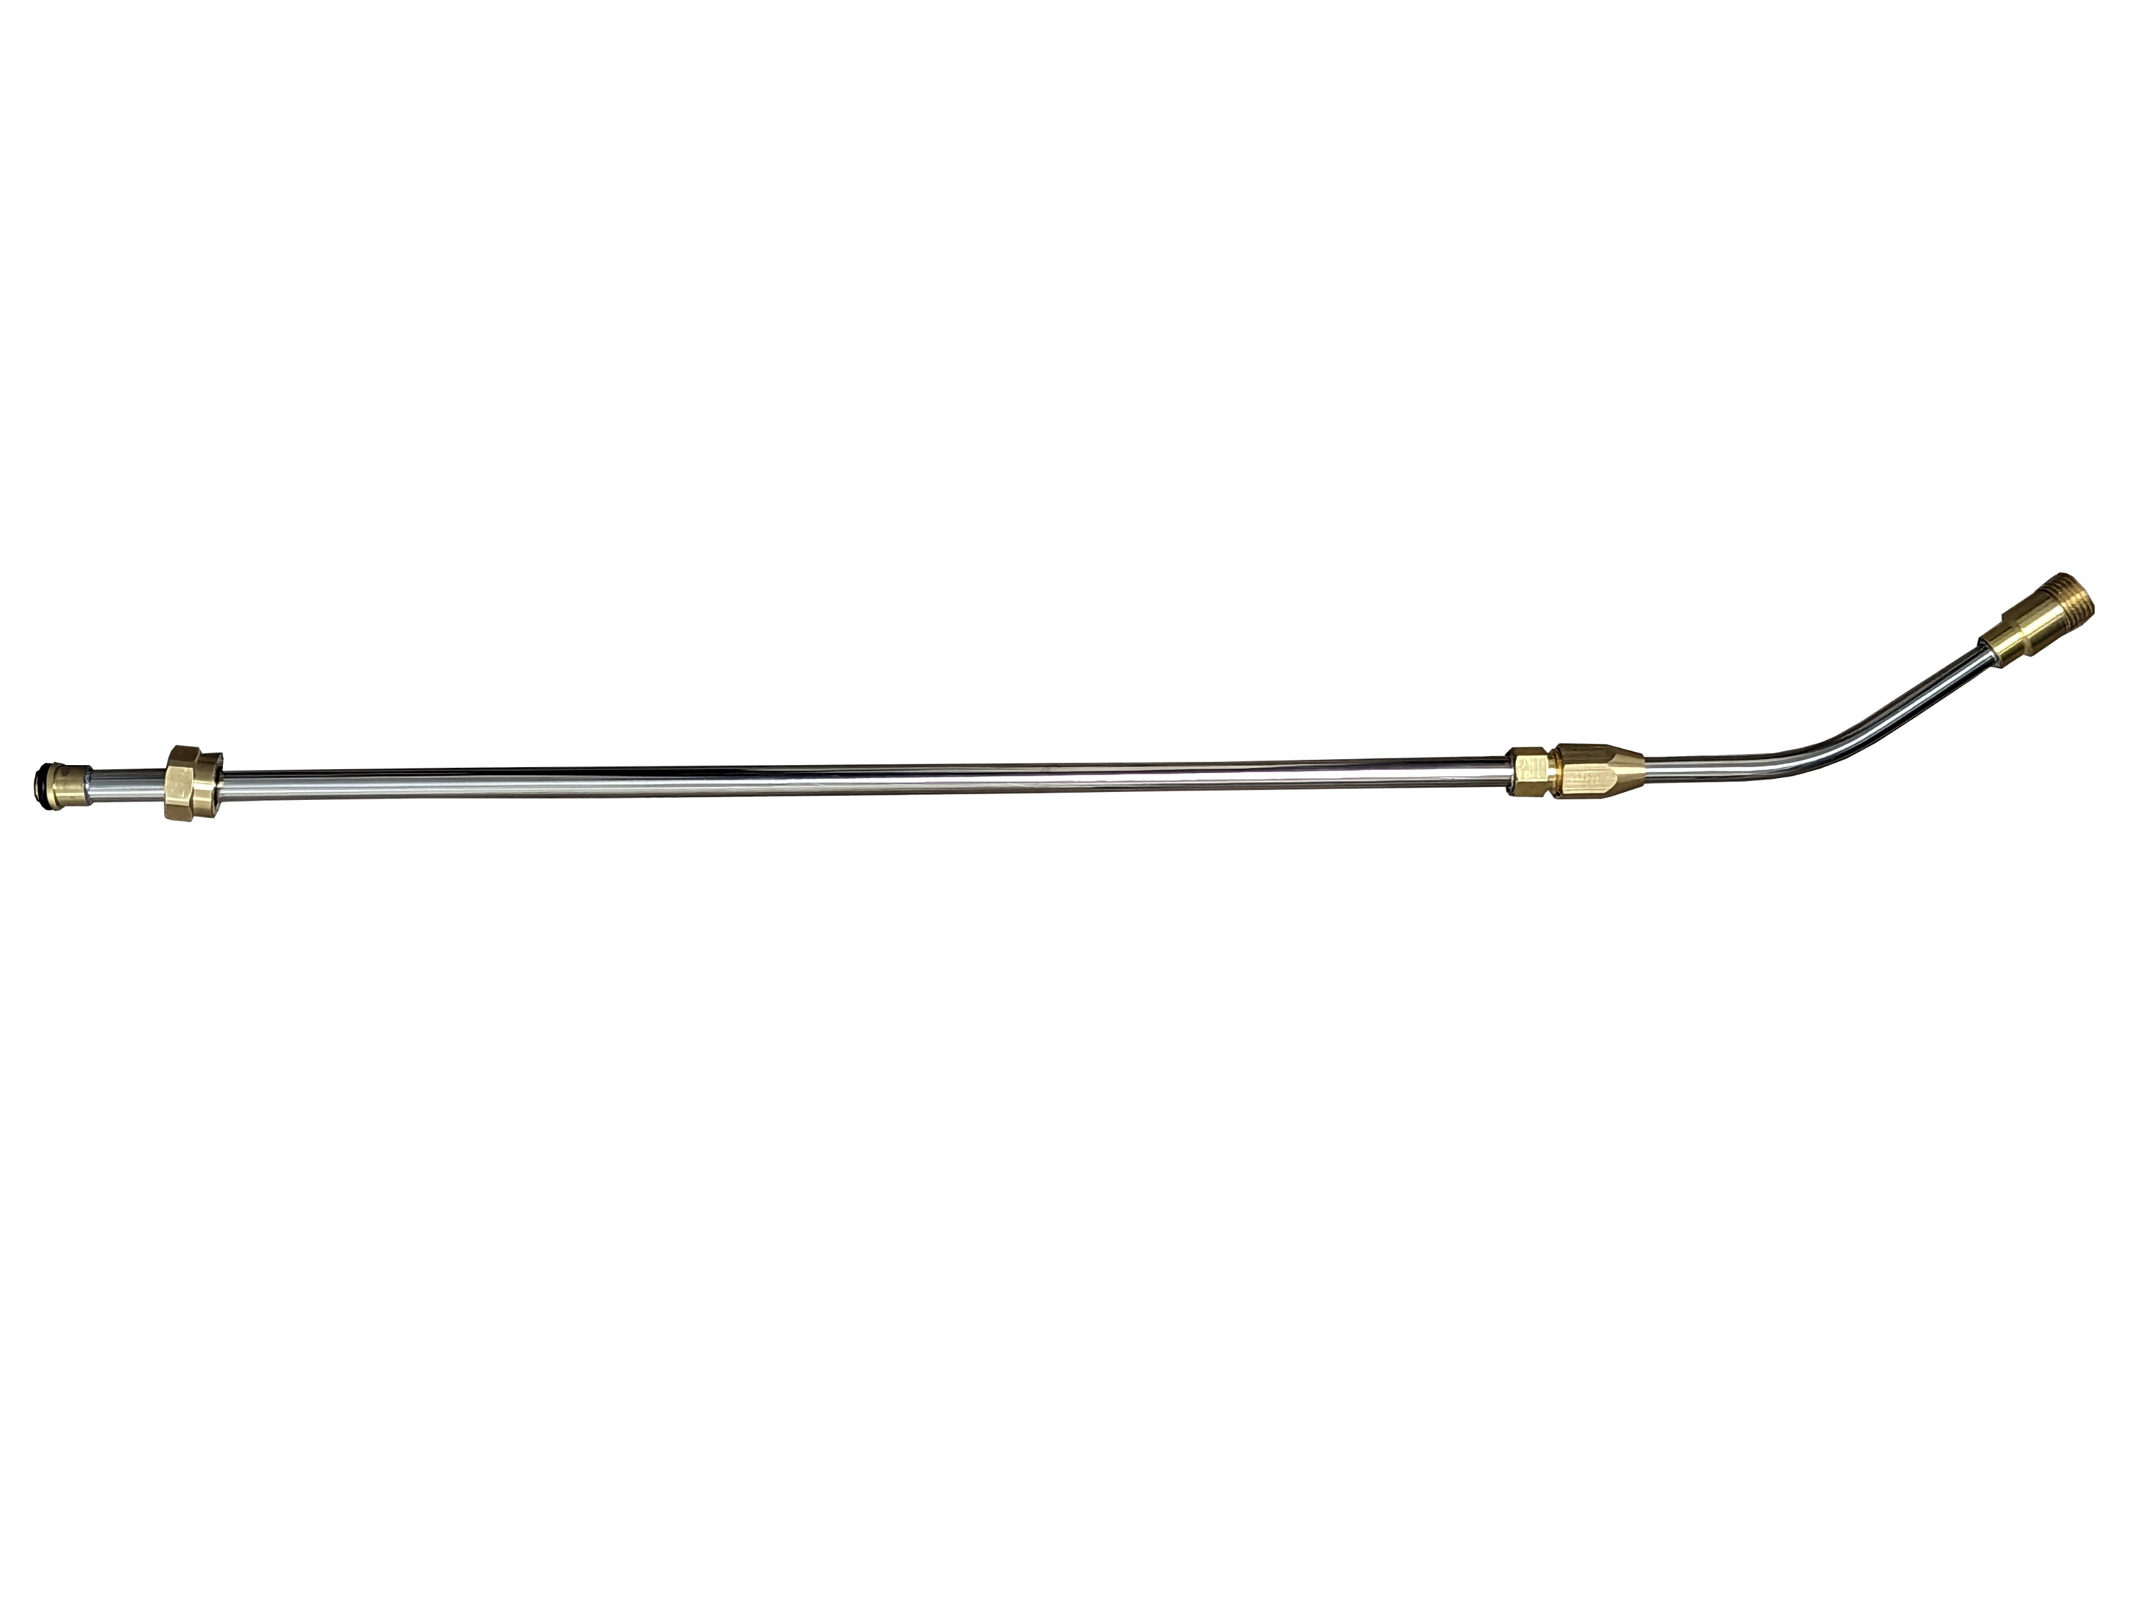
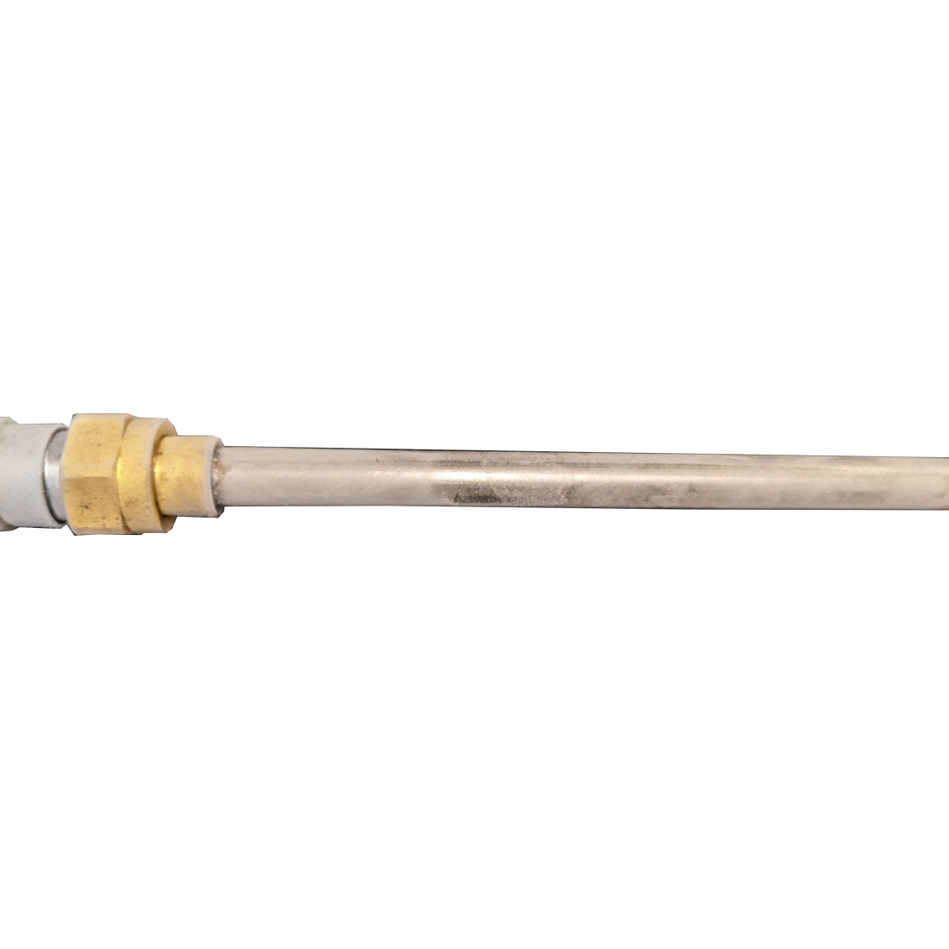
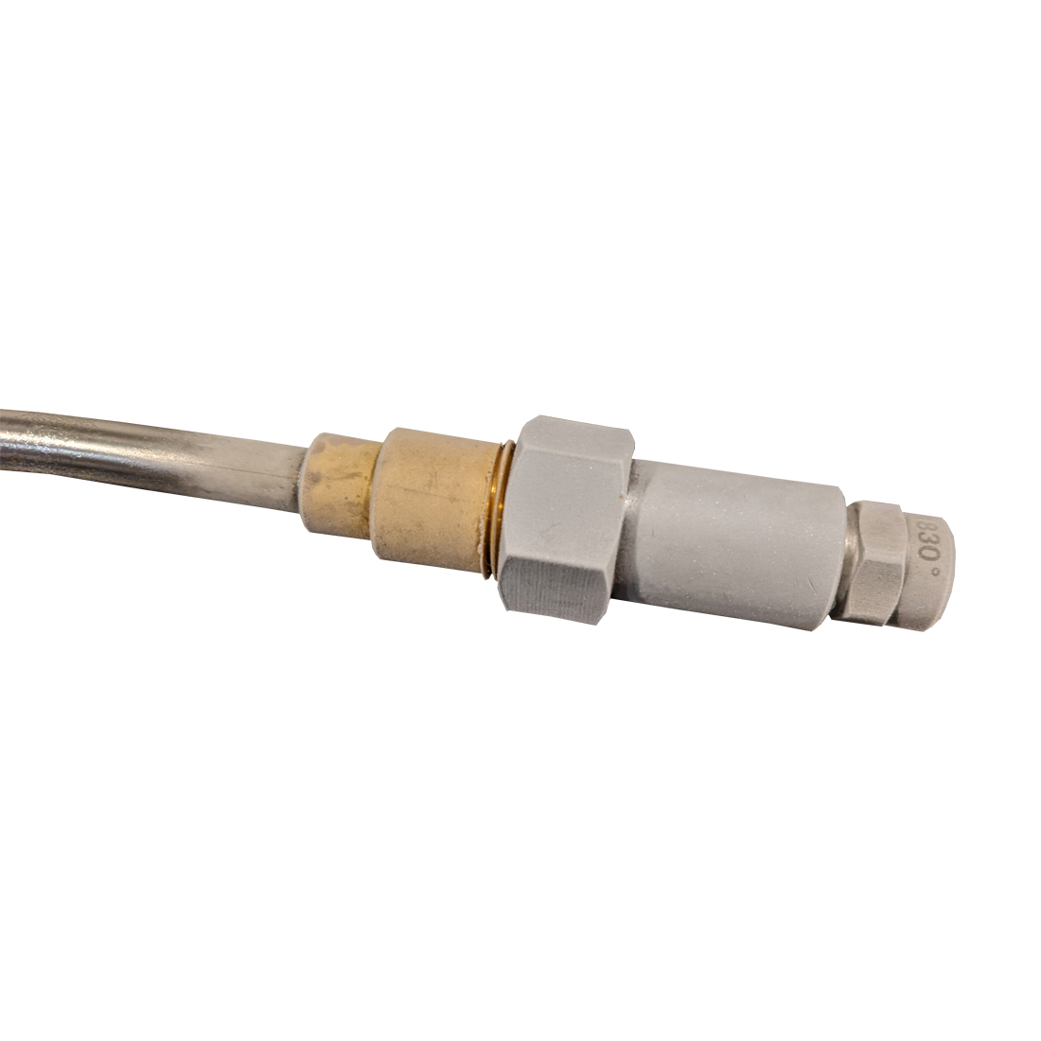
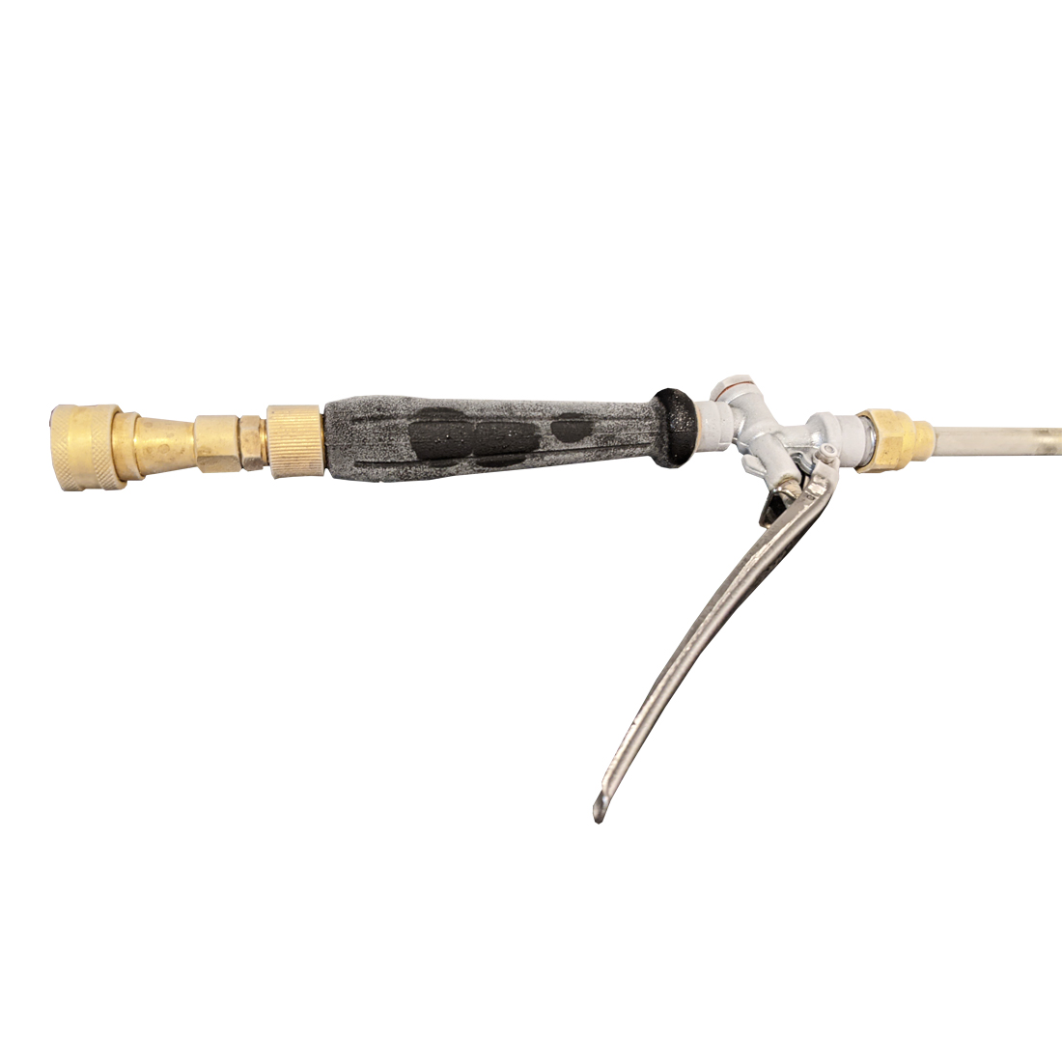
Telescoping Spray Wand
The Telescoping Wand Features
SS tubing is thick for rough service
Telescoping Adjustment Heavy Duty and Standard Service models
Trigger Gun attachment Nut is a swivel design.
Freezing Tests were completed for Trigger Gun and Wand
Complete Trigger Gun and Wand were filled with water.
Complete assembly was kept frozen for 4 days.
No Cracks or split Wands occurred.

Slide 7
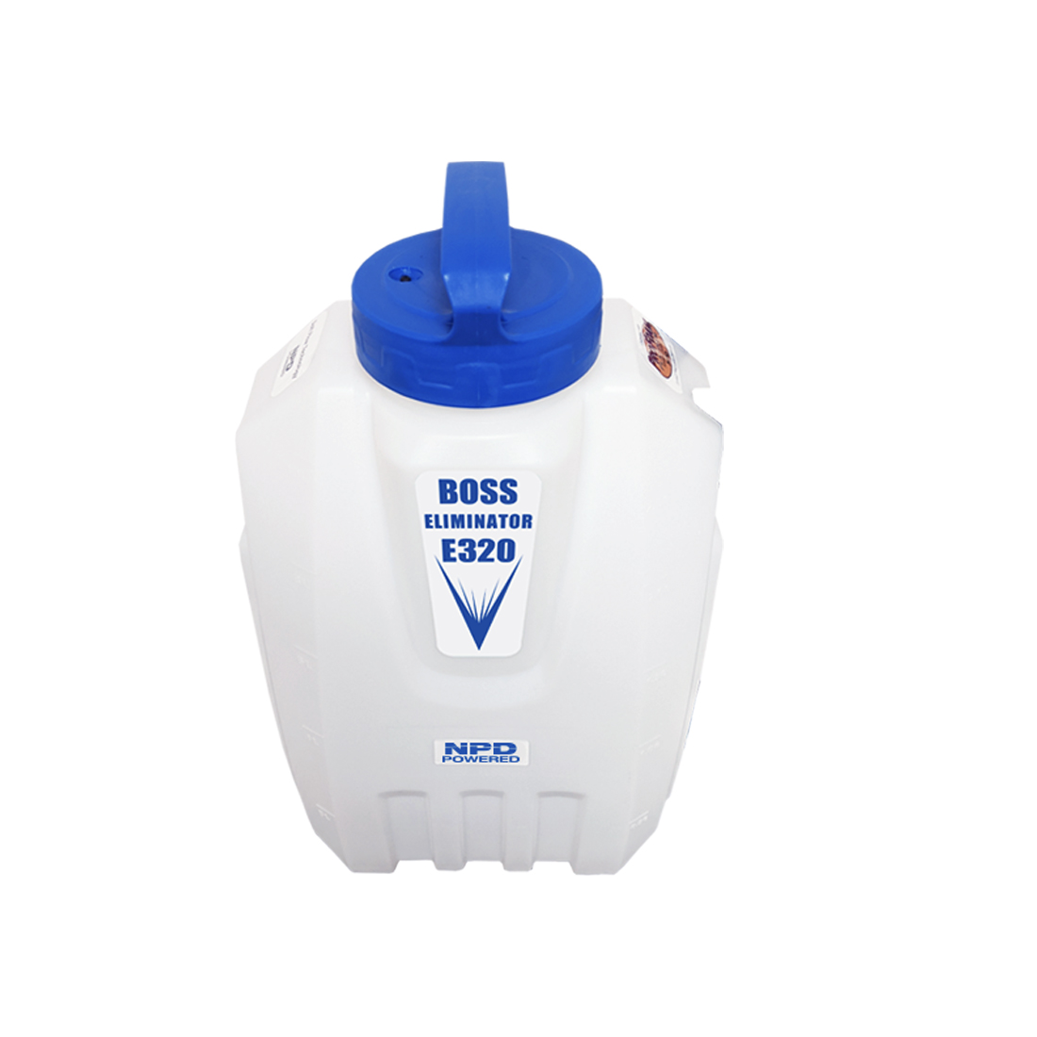
Guideline for Maximum Handling Loads
E-320
28.5 Lbs.
Fully loaded with chemical

Slide 8
Tip Flow Rates
Battery Performance
Speed 2
Consistent volume HDP-M18-30
27oz (800 ml) per minute
All volumes are approximate
Calibrate your applicator
Total Run Time on 1 Battery Charge 1.37 Hours
Total Full Tanks Dispensed 7 = 17.5 gal
Using HDP-M18-30 Mosquito Tip
All volumes are approximate
Calibrate your applicator

Slide 9
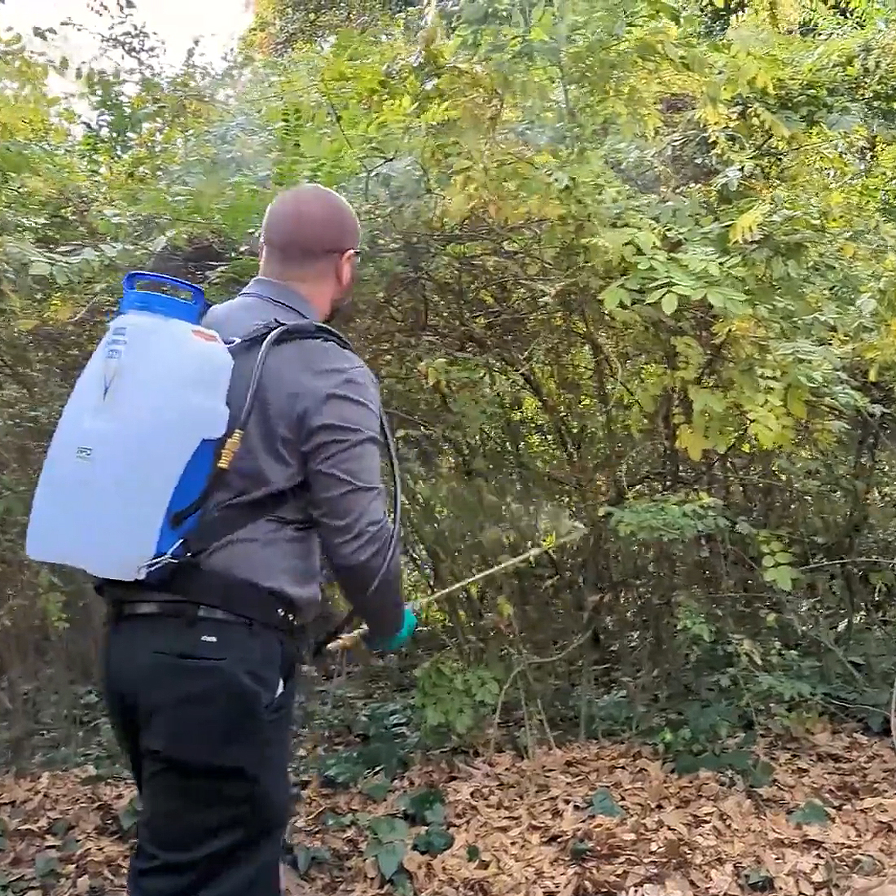
Misting – General Pest Applicator
Speed II / High Flow Tips
08 Pin & Cone
HDP-M18-30
“Mosquito Misting Tip”

Slide 10
General Pest Control
Speed I / Low Flow Tips
01 Fan Spray
03 Pin & Cone
HDP-M1.5
Low Volume Misting
01 Fan Spray Tip
02 Fan Spray Tip

Slide 11
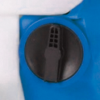
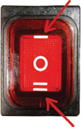
Speed Switch
Speed I = Low Flow
Speed II = High Flow
Fixed Speed control to allow for consistent equipment calibration.
Applicators with Variable Speed control, make it impossible to create an equipment calibration procedure.

Slide 13
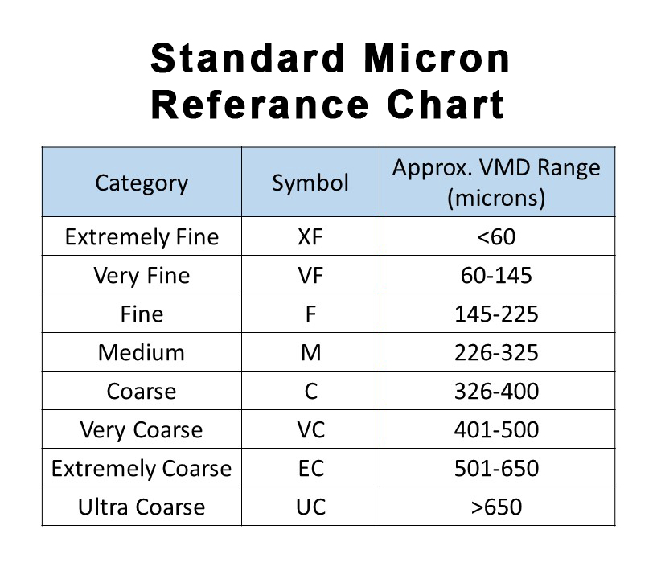
Droplet Analysis
E- Series Eliminator Applicators and HDP 1830 Misting Tip
18v Rechargeable - Operating System, HDP 1830 Misting Tip are a customized set, 4 Models – 1 Gallon, 2.5 Gallon, 4 Gallon and 8 Gallon

Slide 14
Drift Criteria and Average Values at 15 feet
AVG Relative Span of 1.01 – Excellent
Very low variability of droplet sizes and volume supports the integrity of a consistent spray pattern.
Allows for better coverage and less drift, particularly advantageous when performing barrier or perimeter treatments in suburban settings where vegetation and landscape can vary extensively.
AVG DV.1 - 141.76 µm
Supports low potential for drift since 10% of the droplets measured were of this value or smaller.
AVG DV.5 - 255.26 µm
Critical industry standard value (also called VMD - volume median diameter) where 50% of the droplets produced by the HDP 1830 tip are considered MEDIUM by ASABE (American Society of Agricultural and Biological Engineers).
According to the Pesticide Environmental Stewardship website “…an important consideration for reducing drift is to use nozzles that produce higher VMDs (for example, greater than 300 microns).

Slide 15
Drift Criteria and Average Values at 15 feet
AVG DV.9 - 405.65 µm
90% percent of the droplets (DV 0.9) produced were defined as COARSE to VERY COARSE, further reducing off site drift potential of the spray application.
AVG Droplet Density – 59.30 droplets/cm
Droplet density defines how effective the spray application is overall.
Most importantly, an adequate droplet density determines how efficacious the application will be against the target organisms.
AVG Volume Density – 1.30oz/100 sq ft
Data shows that the HDP 1830 spray tip can be confidently used when applying a variety of pesticides for barrier or perimeter treatments.
This value directly relates to the pesticide being applied according to the equipment and pesticide manufacturer’s recommendations, minimizing over-application (excessive exposure to the environment) and under-application (development of pesticide resistance).

Slide 16
Summary
The HDP Misting Tip 1830 is capable of consistently producing droplets within a definable spectrum conducive to mosquito and vector control larvicidal activities using a water-based material. Drift is minimal based on 50% of the droplets (VMD) being over 250 microns (MEDIUM) at 15 feet from the point of the nozzle. The density of droplets as well as the volume of material applied by the Eliminator Series Applicators and HDP Misting Tip 1830 are compatible with pesticide label recommendations.
Prepared by: DropVision AG® proprietary software from Leading Edge Associates.

Slide 17
Summary
The recent introduction of exotic mosquito-borne viruses such as Zika and Dengue has brought a new awareness to controlling container mosquito species at the point source – i.e., our backyards. Unfortunately, mosquito adulticide control has become more challenging due to pesticide resistance being documented at a rapid rate across the US and throughout the world. Interestingly, all mosquito adulticide products are required to list the maximum allowable VMD on the label while only a handful of mosquito-larvicide products include droplet data on the label and almost all barrier treatment product labels are devoid of this language and requirement. The NPD Powered Eliminator Series of Misting Mosquito Applicators provide VMD and Droplet Data Analysis, making it the first Verified Droplet Analysis 18V rechargeable battery-operated Mosquito Applicator.
Prepared by: DropVision AG® proprietary software from Leading Edge Associates.

Slide 18
HDP-M18-30
Distance from Spray Nozzle (ft.) | Relative Span | Dv 0.1 (µm) | Dv 0.5 (µm) | Dv. 0.9 (µm) | Average Percent Coverage (%) | Average Droplet Density (droplets/cm²) | Average Volume Density (gal/ac) | Average Volume Density (oz/100 sq ft)
5 | 1.00 | 267.00 | 504.98 | 775.00 | 9.67 | 76.66 | 15.51 | 4.56
10 | 1.04 | 190.12 | 341.68 | 546.26 | 7.04 | 74.85 | 8.02 | 2.36
15 | 1.01 | 141.76 | 255.26 | 405.65 | 4.57 | 59.30 | 4.44 | 1.30
20 | 0.89 | 143.61 | 235.05 | 353.06 | 3.00 | 42.34 | 2.50 | 0.73

Slide 19
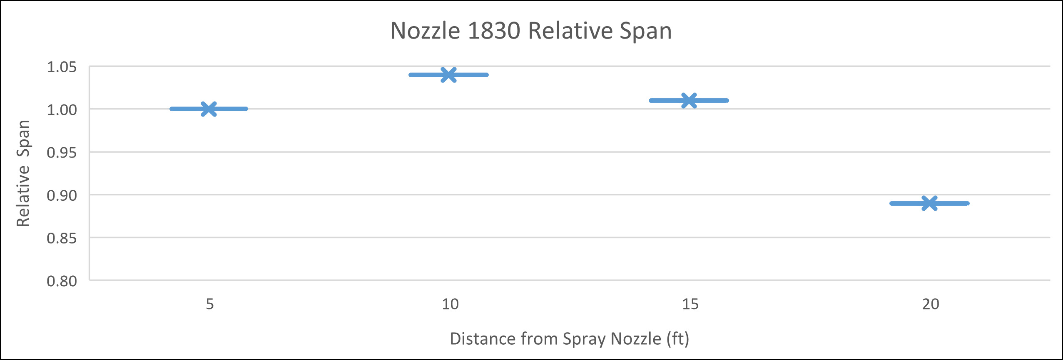
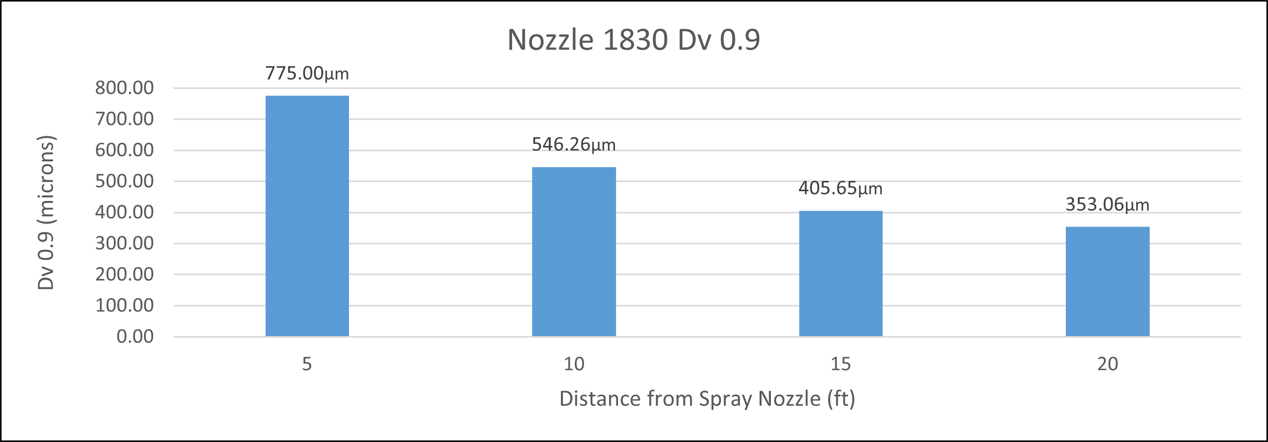
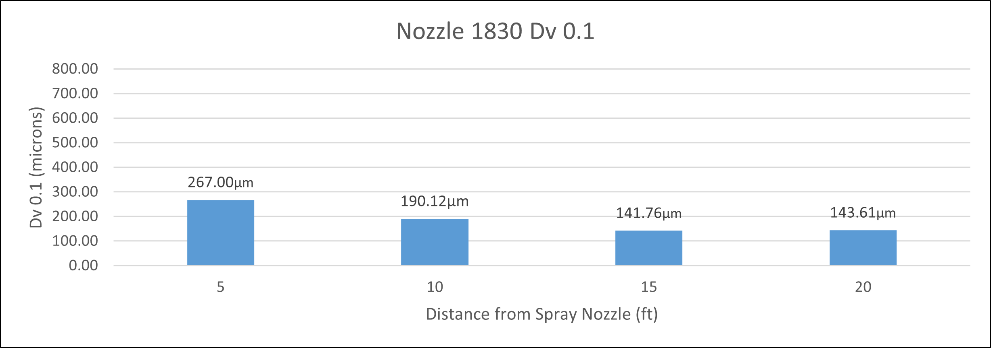
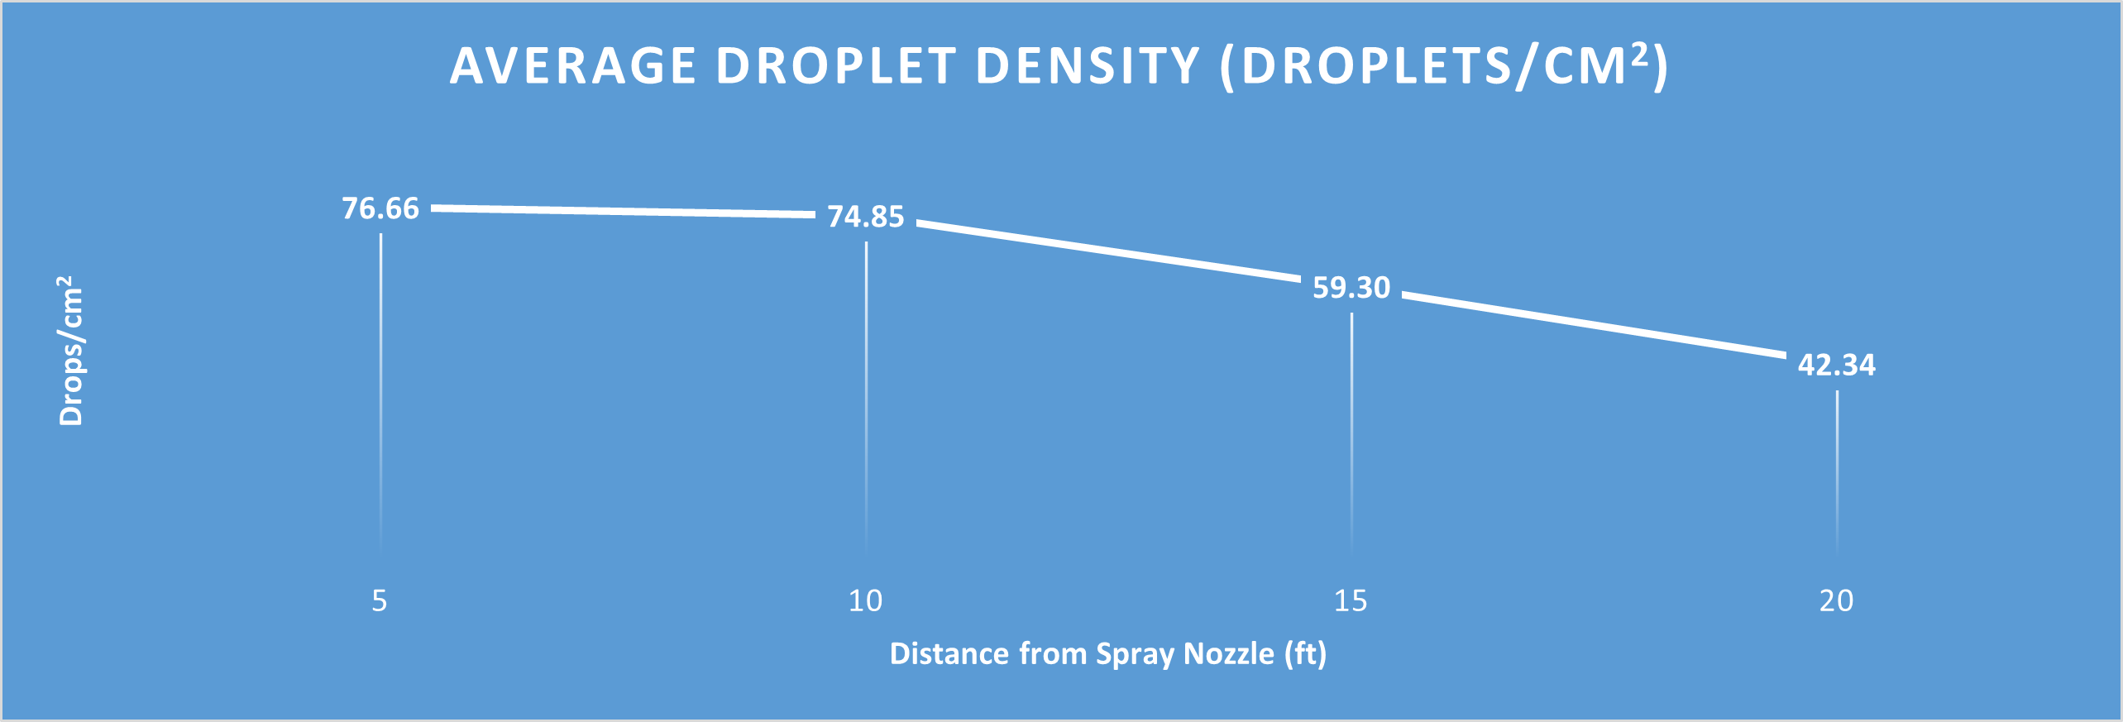
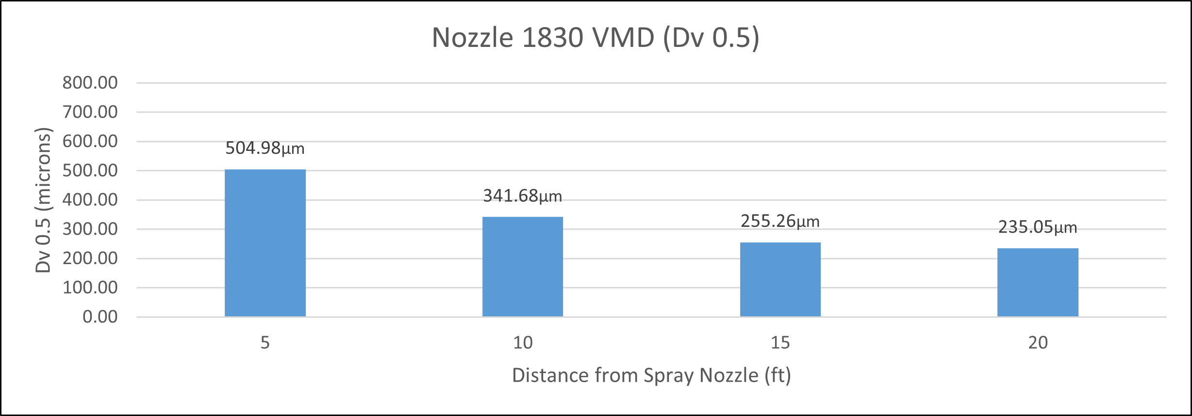
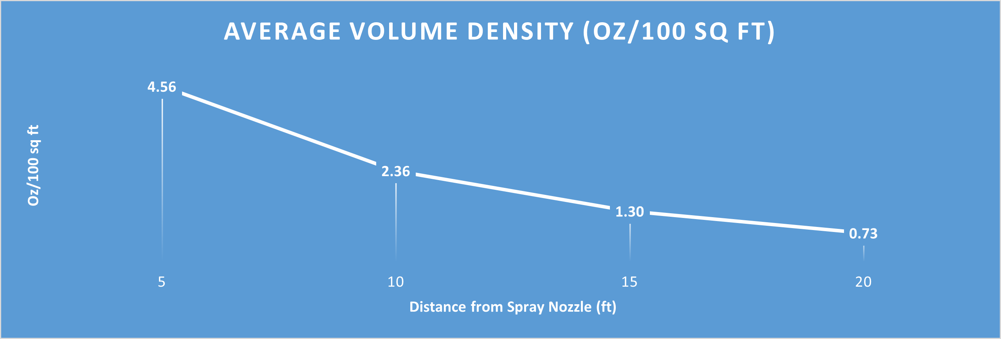
HDP-M18-30

Slide 20
Barrier Treatment Methods
Residential Mosquito Management Revisited
The Backpack Fogger is Obsolete
Click here to download Power Point Presentation
Click here to access PDF Presentation
Dan Killingsworth
AMCA Co-Chair Endangered Species Act Sub-Committee
UF Master’s Program Buckner Lab
Director of Operations
Environmental Security Pest Control
ensec.net dan.killingsworth@pest.com

Slide 21
Contact Information
customercare@npdproducts.com
877-734-0932
www.npdproducts.com
$547.50 CAD
$598.75 CAD
$624.95 CAD
$969.00 CAD

